Slide 1
While loops

Slide 2
Iteration
We’ve seen many places where repetition is necessary in a problem.
We’ve been using the for loop for that purpose
For loops are called definite loops because we know how many times the loop needs to be executed
There are situations where loops are needed but there is no way to determine ahead of time how many times they will run, this is an indefinite loop
This is where a while loop becomes useful
Anything that you can do with a for loop, you can do with an equivalent while loop
There are things that can be done with a while which cannot be done with a for loop (at least, without using break!)

Slide 3
For loops
To control a for loop you can use
  range function- range(10) iterates the variable from 0 to 9
  a list- for i in [3, 9, 23, ‘a’, True]: (i gets every value in the list in that order)
  a string- for i in name: (i gets each character in the string in that order)
  (future) a file- for myline in infile: (myline gets each line in the file in turn)

Slide 4
While loop syntax
while Boolean condition:
  body statements
The Boolean condition is just like the ones in the if statements
The body has to have at least one line, it can be as long as you like

Slide 5
While loop semantics
When executing, the Boolean condition at the top is done first
If it’s False, the body is skipped and execution continues with the next statement after the body (so the body may not be executed at all!) This is why a while loop is called a “pre-test” loop
If the test is True, the body is executed the whole way through, then the Boolean condition at the top is evaluated again
As long as the test stays True, the body will be executed
It is possible to have an infinite loop, if the condition never changes – this is a bug!

Slide 6
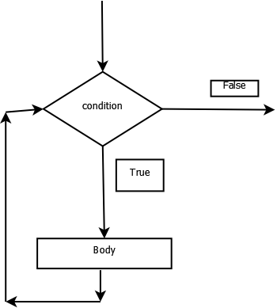
While statement semantics

Slide 7
Controlling while loops
You can control a while loop with a counter
  It is a little more code than for the equivalent for loop
The other way to control a while loop is more general
  Any condition can be used as the Boolean expression at the top
  You can use user input (see Sentinel Logic)
  You can use calculations (“until the number reaches a given value”)
  You can use a flag that indicates some condition that occurred inside the loop

